Slide 1
Artificial Intelligence Lecture 20: Learning from Examples (AIMA Chapter 18 and a little bit of 20)
FALL 2018
Instructor: Prof Sheila Tejada

Slide 2
What is learning?
“Learning denotes changes in a system that ... enable a system to do the same task more efficiently the next time.” –Herbert Simon
“Learning is constructing or modifying representations of what is being experienced.” –Ryszard Michalski
“Learning is making useful changes in our minds.” –Marvin Minsky

Slide 3
Why study learning?
Understand and improve efficiency of human learning
Use to improve methods for teaching and tutoring people (e.g., better computer-aided instruction)
Discover new things or structure previously unknown
Examples: data mining, scientific discovery
Fill in skeletal or incomplete specifications about a domain
Large, complex AI systems can’t be completely built by hand and require dynamic updating to incorporate new information
Learning new characteristics expands the domain or expertise and lessens the “brittleness” of the system
Build agents that can adapt to users, other agents, and their environment

Slide 4
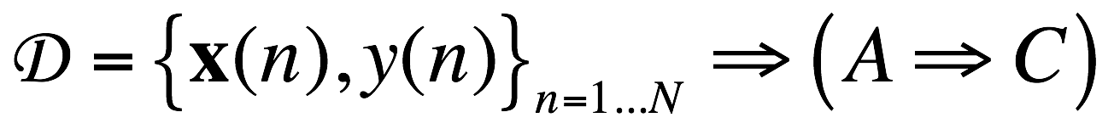
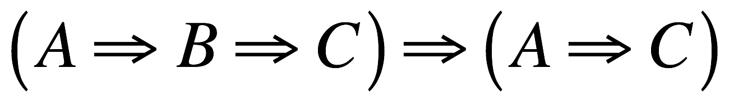
Two types of learning in AI
Deductive: Deduce rules/facts from already known rules/facts. (We have already dealt with this)
Inductive: Learn new rules/facts from a data set D.
We will be dealing with the latter, inductive learning, now

Slide 5
Learning
Learning is essential for unknown environments,
i.e., when designer lacks omniscience
Learning is useful as a system construction method,
i.e., expose the agent to reality rather than trying to write it down
Learning modifies the agent's decision mechanisms to improve performance

Slide 6
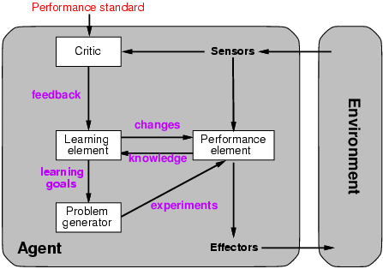
Learning agents

Slide 7
Learning element
Design of a learning element is affected by
Which components of the performance element are to be learned
What feedback is available to learn these components
What representation is used for the components
Type of feedback:
Supervised learning: correct answers for each example
Unsupervised learning: correct answers not given
Reinforcement learning: occasional rewards

Slide 8
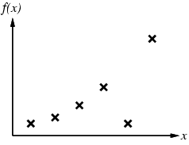
Inductive Learning
Learn a target function f from classified examples
Each example is a pair (x, f(x))
If both x and f are numeric, this is traditional function fitting
AI traditionally focused on cases where x is described discretely/symbolically and f is either Boolean or discrete
Modern methods may do both
f(Robin: WarmB & LayE & Fly)=Bird
f(Bat: WarmB & ¬LayE & Fly)=Mammal
f(Pteranodon: ColdB & LayE & Fly)=Reptile
f(Ostrich: WarmB & LayE & ¬Fly)=Bird

Slide 9
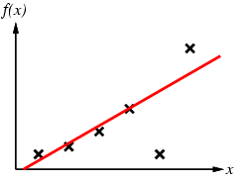
Inductive Learning
Problem:
Find a hypothesis h in Hypothesis Space (H), e.g.
Univariate polynomial functions
Boolean feature vectors
Such that h ≈ f
Given training set of examples
WarmB & LayE ⇒ Bird

Slide 10
Inductive Learning Method
Construct or adjust h to agree with f on training set
h is consistent if it agrees with f on all examples
f is realizable in H if there is some h∈H that exactly represents f
Although, often must be satisfied with best approximation
Generally search through H until find a “good” h
If H is defined via a concept description language there is usually an implicit generalization hierarchy
Can search this hierarchy from specific to general, or vice versa
Or there may be a measure of simplicity on H so that can search from simple to complex
Using Ockham’s razor to choose simplest consistent, or good, h
…
¬Fly
Fly
WarmB
LayE
…
¬Fly & WarmB
Fly & WarmB
WarmB & LayE
…
¬Fly & WarmB & LayE
Fly & WarmB & LayE

Slide 11
Curve Fitting From Simple to Complex

Slide 12
Curve Fitting From Simple to Complex
Linear

Slide 13
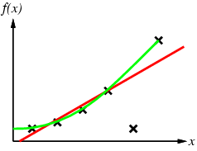
Curve Fitting From Simple to Complex
Quadratic
If willing to treat remaining point as noise, could stop here

Slide 14
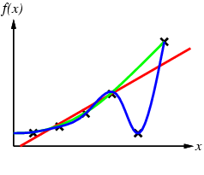
Curve Fitting From Simple to Complex

Slide 15
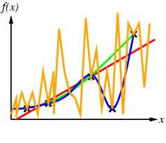
Curve Fitting From Simple to Complex
By Ockham’s razor, should prefer blue to orange

Slide 16
Learning decision trees
In some other problems, a single A vs. B classification is not sufficient.
For example:
Problem: decide whether to wait for a table at a restaurant, based on the following attributes:
Alternate: is there an alternative restaurant nearby?
Bar: is there a comfortable bar area to wait in?
Fri/Sat: is today Friday or Saturday?
Hungry: are we hungry?
Patrons: number of people in the restaurant (None, Some, Full)
Price: price range ($, $$, $$$)
Raining: is it raining outside?
Reservation: have we made a reservation?
Type: kind of restaurant (French, Italian, Thai, Burger)
WaitEstimate: estimated waiting time (0-10, 10-30, 30-60, >60)

Slide 17
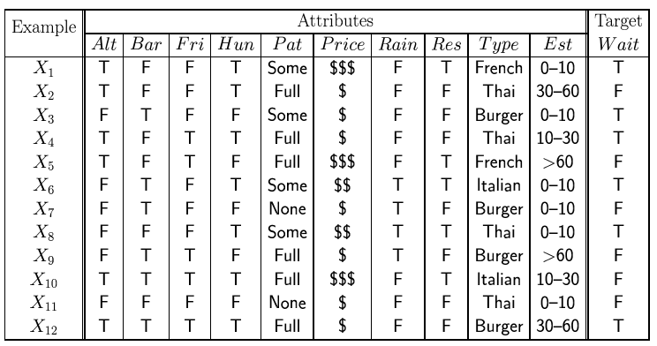
Attribute-based representations
Examples described by attribute values (Boolean, discrete, continuous)
E.g., situations where I will/won't wait for a table:
Classification of examples is positive (T) or negative (F)

Slide 18
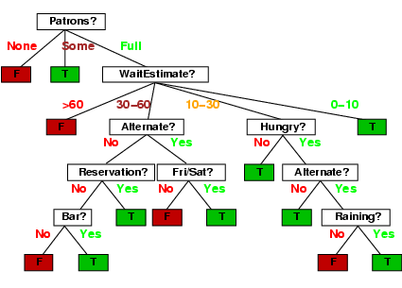
Decision trees
One possible representation for hypotheses
E.g., here is the “true” (designed manually by thinking about all cases) tree for deciding whether to wait:
Could we learn this tree from examples instead of designing it by hand?

Slide 19
Inductive learning of decision tree
Simplest: Construct a decision tree with one leaf for every example = memory based learning. Not very good generalization.
Advanced: Split on each variable so that the purity of each split increases (i.e. either only yes or only no)
Purity measured,e.g, with entropy

Slide 20
Inductive learning of decision tree
Simplest: Construct a decision tree with one leaf for every example = memory based learning. Not very good generalization.
Advanced: Split on each variable so that the purity of each split increases (i.e. either only yes or only no)
Purity measured,e.g, with entropy

Slide 21
Inductive learning of decision tree
Simplest: Construct a decision tree with one leaf for every example = memory based learning. Not very good generalization.
Advanced: Split on each variable so that the purity of each split increases (i.e. either only yes or only no)
Purity measured,e.g, with entropy
General form:

Slide 22
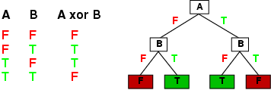
Expressiveness
Decision trees can express any function of the input attributes.
E.g., for Boolean functions, truth table row → path to leaf:
Trivially, there is a consistent decision tree for any training set with one path to leaf for each example (unless f nondeterministic in x) but it probably won't generalize to new examples
Prefer to find more compact decision trees

Slide 23
Hypothesis spaces
How many distinct decision trees with n Boolean attributes?
= number of Boolean functions
= number of distinct truth tables with 2^{n} rows = 2^{2n}
E.g., with 6 Boolean attributes, there are 18,446,744,073,709,551,616 possible trees

Slide 24
Hypothesis spaces
How many distinct decision trees with n Boolean attributes?
= number of Boolean functions
= number of distinct truth tables with 2^{n} rows = 2^{2n}
E.g., with 6 Boolean attributes, there are 18,446,744,073,709,551,616 trees
How many purely conjunctive hypotheses (e.g., Hungry ∧ ¬Rain)?
Each attribute can be in (positive), in (negative), or out
⇒ 3^{n} distinct conjunctive hypotheses
More expressive hypothesis space
increases chance that target function can be expressed
increases number of hypotheses consistent with training set
⇒ may get worse predictions

Slide 25
ID3 Algorithm
A greedy algorithm for decision tree construction developed by Ross Quinlan circa 1987
Top-down construction of decision tree by recursively selecting “best attribute” to use at the current node in tree
Once attribute is selected for current node, generate child nodes, one for each possible value of selected attribute
Partition examples using the possible values of this attribute, and assign these subsets of the examples to the appropriate child node
Repeat for each child node until all examples associated with a node are either all positive or all negative

Slide 26
Choosing the best attribute
Key problem: choosing which attribute to split a given set of examples
Some possibilities are:
Random: Select any attribute at random
Least-Values: Choose the attribute with the smallest number of possible values
Most-Values: Choose the attribute with the largest number of possible values
Max-Gain: Choose the attribute that has the largest expected information gain–i.e., attribute that results in smallest expected size of subtrees rooted at its children
The ID3 algorithm uses the Max-Gain method of selecting the best attribute

Slide 27
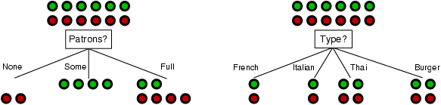
Choosing an attribute
Idea: a good attribute splits the examples into subsets that are (ideally) "all positive" or "all negative"
Patrons? is a better choice

Slide 28
Using information theory
To implement Choose-Attribute in the DTL algorithm
Information Content (Entropy):
I(P(v₁), … , P(v_{n})) = Σ_{i=1} -P(v_{i}) log₂ P(v_{i})
For a training set containing p positive examples and n negative examples:

Slide 29
Information theory 101
Information theory sprang almost fully formed from the seminal work of Claude E. Shannon at Bell Labs
A Mathematical Theory of Communication, Bell System Technical Journal, 1948.
Intuitions
Common words (a, the, dog) are shorter than less common ones (parlimentarian, foreshadowing)
In Morse code, common (probable) letters have shorter encodings
Information is measured in minimum number of bits needed to store or send some information
Wikipedia: The measure of data, known as information entropy, is usually expressed by the average number of bits needed for storage or communication.

Slide 30
Information theory 101
Information is measured in bits
Information conveyed by message depends on its probability
With n equally probable possible messages, the
probability p of each is 1/n
Information conveyed by message is -log(p) = log(n)
e.g., with 16 messages, then log(16) = 4 and we need 4 bits to identify/send each message
Given probability distribution for n messages P = (p₁,p₂…p_{n}), the information conveyed by distribution (aka entropy of P) is:
I(P) = -(p₁*log(p₁) + p₂*log(p₂) + .. + p_{n}*log(p_{n}))
probability of msg 2
info in msg 2

Slide 31
Information theory II
Information conveyed by distribution (a.k.a. entropy of P):
I(P) = -(p₁*log(p₁) + p₂*log(p₂) + .. + p_{n}*log(p_{n}))
Examples:
If P is (0.5, 0.5) then I(P) = .5*1 + 0.5*1 = 1
If P is (0.67, 0.33) then I(P) = -(2/3*log(2/3) + 1/3*log(1/3)) = 0.92
If P is (1, 0) then I(P) = 1*1 + 0*log(0) = 0
The more uniform the probability distribution, the greater its information: More information is conveyed by a message telling you which event actually occurred
Entropy is the average number of bits/message needed to represent a stream of messages

Slide 32
Information gain
A chosen attribute A divides the training set E into subsets E₁, … , E_{v} according to their values for A, where A has v distinct values.
Information Gain (IG) or reduction in entropy from the attribute test:
Choose the attribute with the largest IG

Slide 33
Information gain
For the training set, p = n = 6, I(6/12, 6/12) = 1 bit
Consider the attributes Patrons and Type (and others too):
Patrons has the highest IG of all attributes and so is chosen by the DTL algorithm as the root

Slide 34
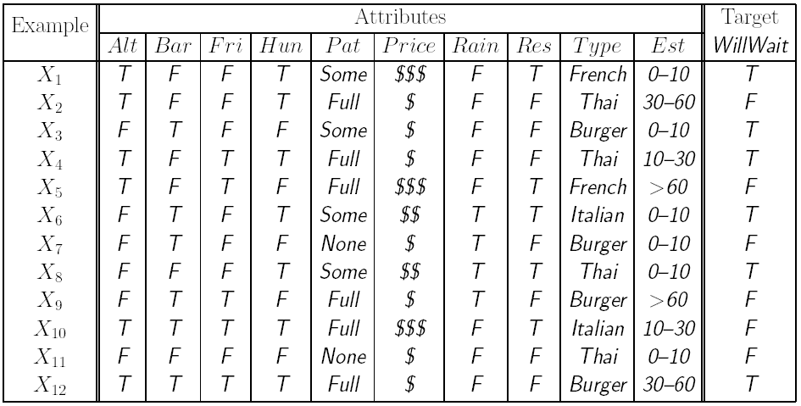
Decision tree learning example
Alternate?
Yes
No
3 T, 3 F
3 T, 3 F
Entropy decrease = 0.30 – 0.30 = 0
NOTE: These examples use ln(.) and not log₂(.) like previous slides
decisions are the same since both logs are linearly related

Slide 35
Decision tree learning example
Bar?
Yes
No
3 T, 3 F
3 T, 3 F
Entropy decrease = 0.30 – 0.30 = 0

Slide 36
Decision tree learning example
Sat/Fri?
Yes
No
2 T, 3 F
4 T, 3 F
Entropy decrease = 0.30 – 0.29 = 0.01

Slide 37
Decision tree learning example
Hungry?
Yes
No
5 T, 2 F
1 T, 4 F
Entropy decrease = 0.30 – 0.24 = 0.06

Slide 38
Decision tree learning example
Raining?
Yes
No
2 T, 2 F
4 T, 4 F
Entropy decrease = 0.30 – 0.30 = 0

Slide 39
Decision tree learning example
Reservation?
Yes
No
3 T, 2 F
3 T, 4 F
Entropy decrease = 0.30 – 0.29 = 0.01

Slide 40
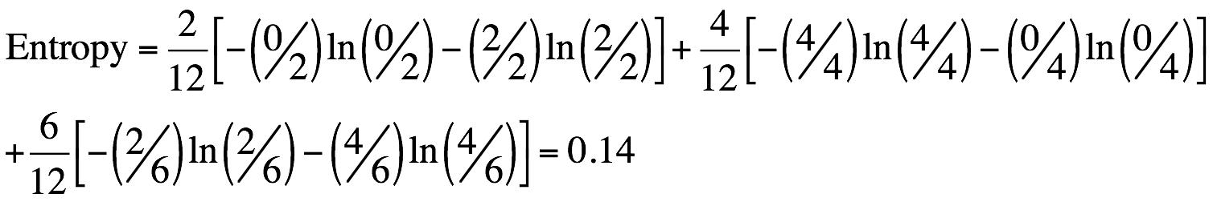
Decision tree learning example
Patrons?
None
Full
2 F
Some
2 T, 4 F
4 T
Entropy decrease = 0.30 – 0.14 = 0.16

Slide 41
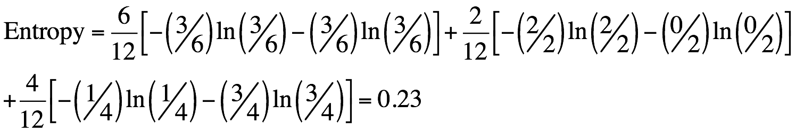
Decision tree learning example
Price
$
$$$
3 T, 3 F
$$
1 T, 3 F
2 T
Entropy decrease = 0.30 – 0.23 = 0.07

Slide 42
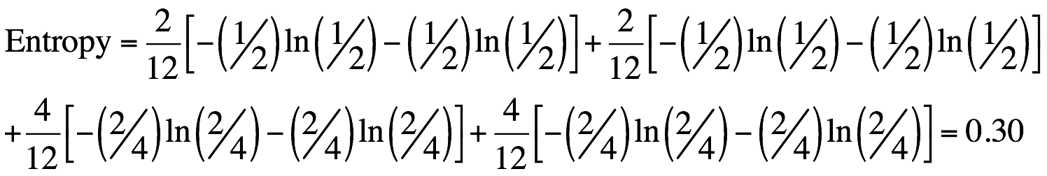
Decision tree learning example
Type
French
Burger
1 T, 1 F
2 T, 2 F
Italian
Thai
1 T, 1 F
2 T, 2 F
Entropy decrease = 0.30 – 0.30 = 0

Slide 43
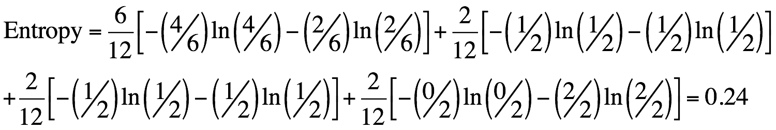
Decision tree learning example
Est. waiting time
0-10
> 60
4 T, 2 F
2 F
10-30
30-60
1 T, 1 F
1 T, 1 F
Entropy decrease = 0.30 – 0.24 = 0.06

Slide 44
Decision tree learning example
Patrons?
Largest entropy decrease (0.16) achieved by splitting on Patrons.
None
Full
2 F
Some
X?
2 T, 4 F
Continue like this, making new splits, always purifying nodes.
4 T

Slide 45
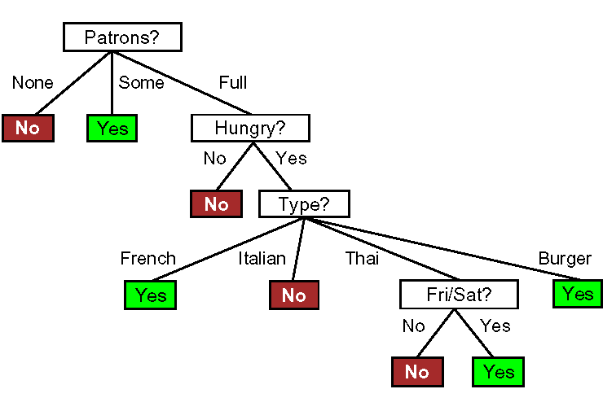
Decision tree learning example
Induced tree (from examples)

Slide 46
Decision tree learning example
Induced tree (from examples)
Cannot make it more complex than what the data supports.

Slide 47
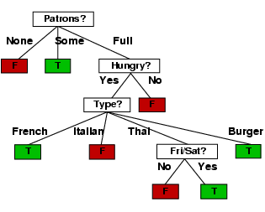
Example (Cont.)
Decision tree learned from the 12 examples:
Substantially simpler than tree created by hand
More complex hypothesis isn’t justified by small amount of data available

Slide 48
How do we know it is correct?
How do we know that h ≈ f ? (Hume's Problem of Induction)
Try h on a new test set of examples (cross validation)
...and assume the ”principle of uniformity”, i.e. the result we get on this test data should be indicative of results on future data. Causality is constant.
Inspired by a slide by V. Pavlovic

Slide 49
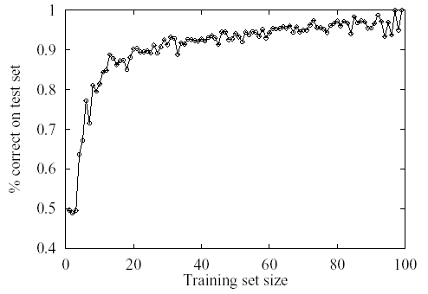
Learning curve for the decision tree algorithm on 100 randomly generated examples in the restaurant domain.
The graph summarizes 20 trials.

Slide 50
Cross-validation
Use a “validation set”.
Split your data set into two
parts, one for training your
model and the other for
validating your model.
The error on the validation
data is called “validation error”
(E_{val})
D_{train}
D_{val}
E_{val}

Slide 51
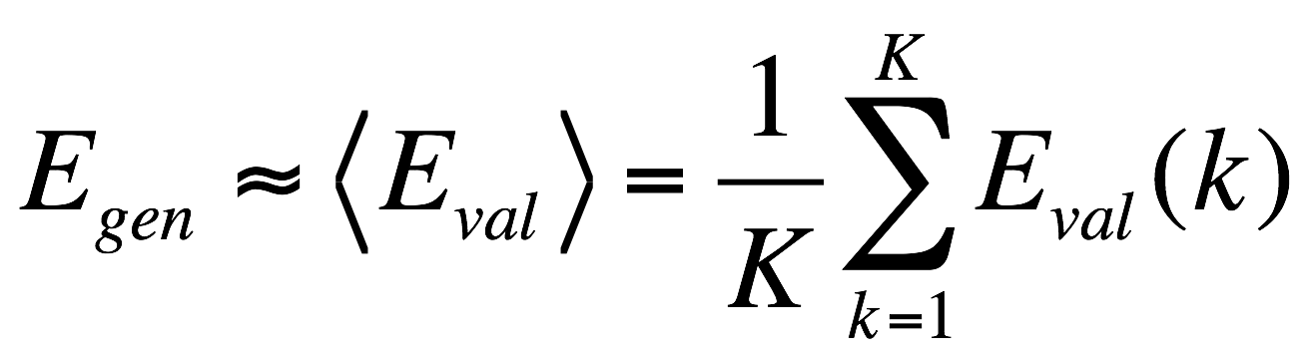
K-Fold Cross-validation
More accurate than using only one validation set.
D_{train}
D_{val}
D_{train}
D_{val}
D_{train}
D_{val}
D_{train}
E_{val}(1)
E_{val}(2)
E_{val}(3)

Slide 52
Data Mining
1) C4.5 and other decision trees (AIMA 18.3.3)
Finite domains for the attributes
2) k-means
Unsupervised, nonparametric like k-nearest neighbors
3) SVMs (AIMA 18.9)
Minimize data needed to store, transform nonlinear into linear
4) Apriori
Unsupervised, learn association rules from databases
5) EM (AIMA 20.3)
Learn probabilities, even over unlabeled variables

Slide 53
Data Mining
6) PageRank (AIMA 22.3.4)
The kind of data determines the kind of learning
7) AdaBoost (AIMA 18.10)
Learn multiple classifiers and then combine their output
8) k-Nearest Neighbors (AIMA 18.8.1)
Use the data as a map of the classification space
9) Naive Bayes (AIMA 20.2.2)
Assume probabilistic independence among influences
10) CART (AIMA 18.3.6)
Extend decision trees into regression trees (i.e., real values)

